Slide 1
Mining

Slide 2
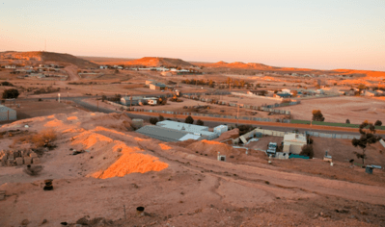
By the end of this lesson on mining you should be able to do the following:
Explain opencast mining.
Explain underground mining.
Understand why many people want to replace coal with renewable energy sources.

Slide 3
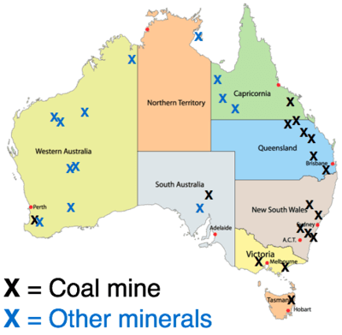
Australia has many useful resources that can be mined, including coal, gold, uranium, copper, iron ore, nickel, silver and bauxite (aluminium ore).
Over one-third of the world's bauxite is mined in Australia!

Slide 4
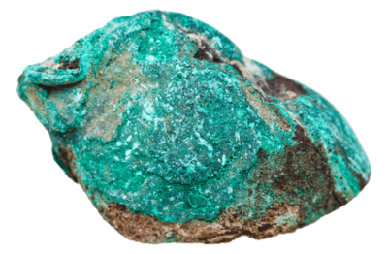
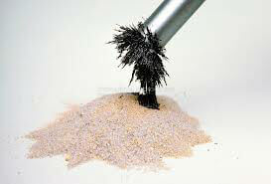
To find where to mine for minerals, scientists can look for certain colours that come from minerals dissolved in water. For example, copper has a blue or green colour that is easy to spot.
Minerals that contain iron, nickel, or cobalt can be detected because of their magnetic properties - they stick to a magnet!

Slide 5
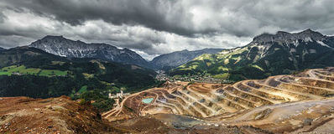
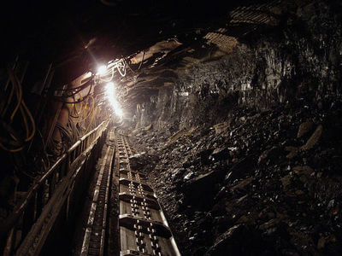
Once the mineral ore is found, it must be removed. Mining is the process of removing mineral ore from the ground.
There are different methods of mining, depending on how close the mineral ore is to the surface and what type of rocks are above it.
There are two main types of mining:
• Opencast mining
• Underground mining

Slide 6
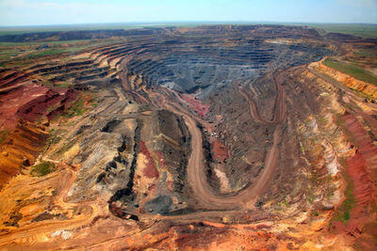
Opencast mining (or opencut mining) is used to extract minerals close to the surface.
The mineral ores are exposed by making a large hole, then explosives are used to break up the rocks. Trucks then transport the ores out of the mine, so they can be processed.

Slide 7
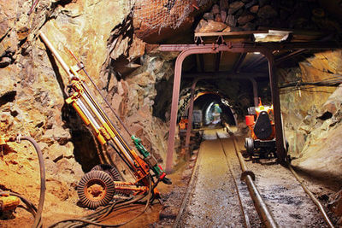
Underground mining is used when the mineral ores are deep below the surface.
Tunnels are dug into the ground to reach the mineral ore. They can go as deep as 4 kilometres into the ground! The temperature gets very high this deep in the ground.
Underground mining is more dangerous than opencast mining, because of the risks of flooding, toxic gas leaks, explosions, or tunnels caving in.

Slide 8
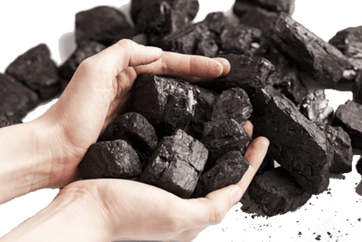
Coal is an extremely useful resource!
It provides 69% of Australia's electricity, but is also used for heating and to produce the steel in buildings.
We find coal in rocks, so we have to use mining to get it out of the ground. Coal mining is a massive industry in Australia. Do you know anyone who works as a coal miner?

Slide 9
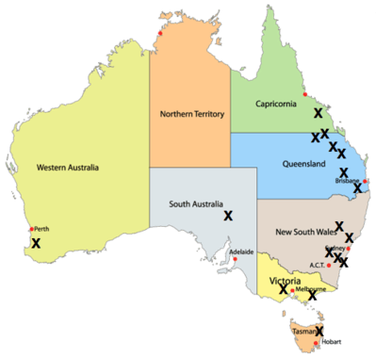
This map shows where major coal mines (X) are found in Australia.
Most of them are around the east coast, close to where the big cities are:

Slide 10
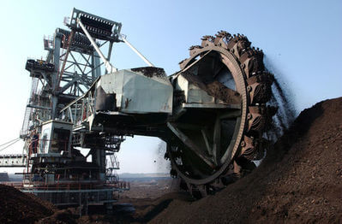
Just like with mineral ore mining, coal can be mined with opencast or underground mining.
Opencast coal mining uses giant bucket-wheel excavators to expose the coal beneath the surface. These excavators can be up to 80 metres long - almost the length of a football field!

Slide 11
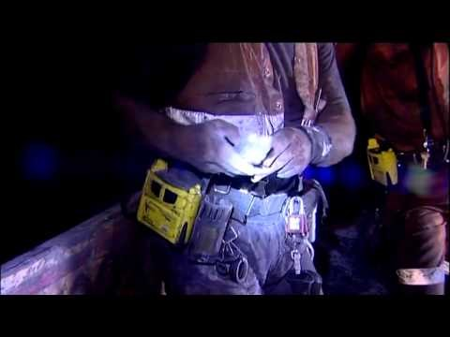

Slide 12
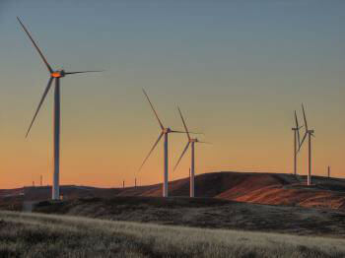
Coal and other ores are non-renewable resources.
They are being mined much faster than natural processes can replace them.
It was predicted that we'd run out of fossil fuels early in the 21st Century... that's soon! So people are looking to replace them with renewable power sources like wind and solar energy.

Slide 13

Indigenous Australians have sustainably managed Australian lands for up to 50,000 years.
There is evidence that they mined for minerals such as ochre for almost 40,000 years!

Slide 14
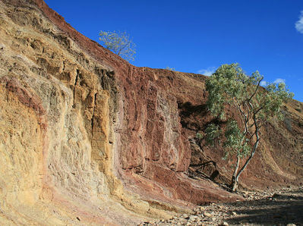
When Europeans first arrived in Australia, their activities were not sustainable.
Uranium and coal mining took place on Indigenous Australian land without permission!
Protests over this led to the Aboriginal Land Rights Act of 1976, recognising the Indigenous Australians' claim to the land, which they cared for over thousands of years.
This law means that Indigenous Australians are now consulted about any use of their land and their sacred sites are not to be disturbed.

